Slide 1
Dynamixel servo motor
AX-12A

Slide 2
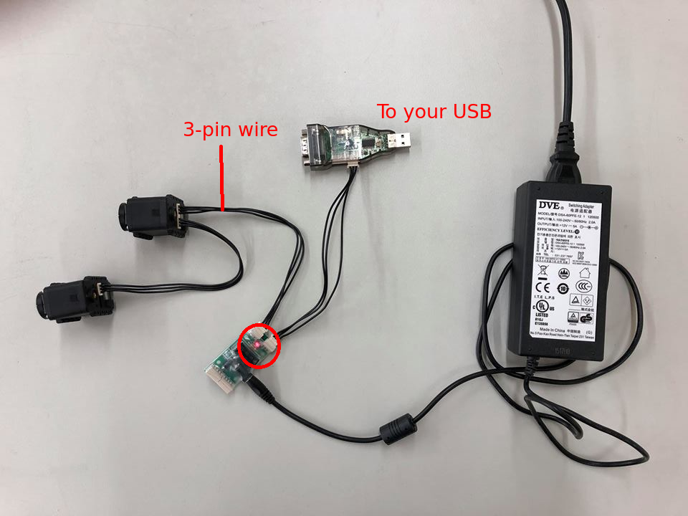
DC motor + gear reducer + encoder
Voltage: 9~12V (11.1V recommended)
Gear ration: 254: 1
Rotation range: -150 ~ 150 degrees
Protocal: serial (7343bps ~ 1Mbps)
Connection:
daisy chain with 3-pin wire
Feedback:
Position
Temperature
Load
Input voltage
...

